Slide 1
Group 17
Daniel, Andrei, Luke, Yurii

Slide 2
Sumo Digital Brief
Single Player.
Identify integral mechanics of a genre or game type.
Develop game without specific mechanic.
Substitute mechanic with refined solution.
Emphasis on a single mechanic.

Slide 3
Our response to the brief.
Substitute refined controlled movement for launch mechanic.
Simple Input – Emphasis on mechanic.
Non-twitch/ Puzzler gameplay.
Hard fun (challenge).
We want our players to experience frustration and fiero.
Learn – Practice – Master game loop.

Slide 4
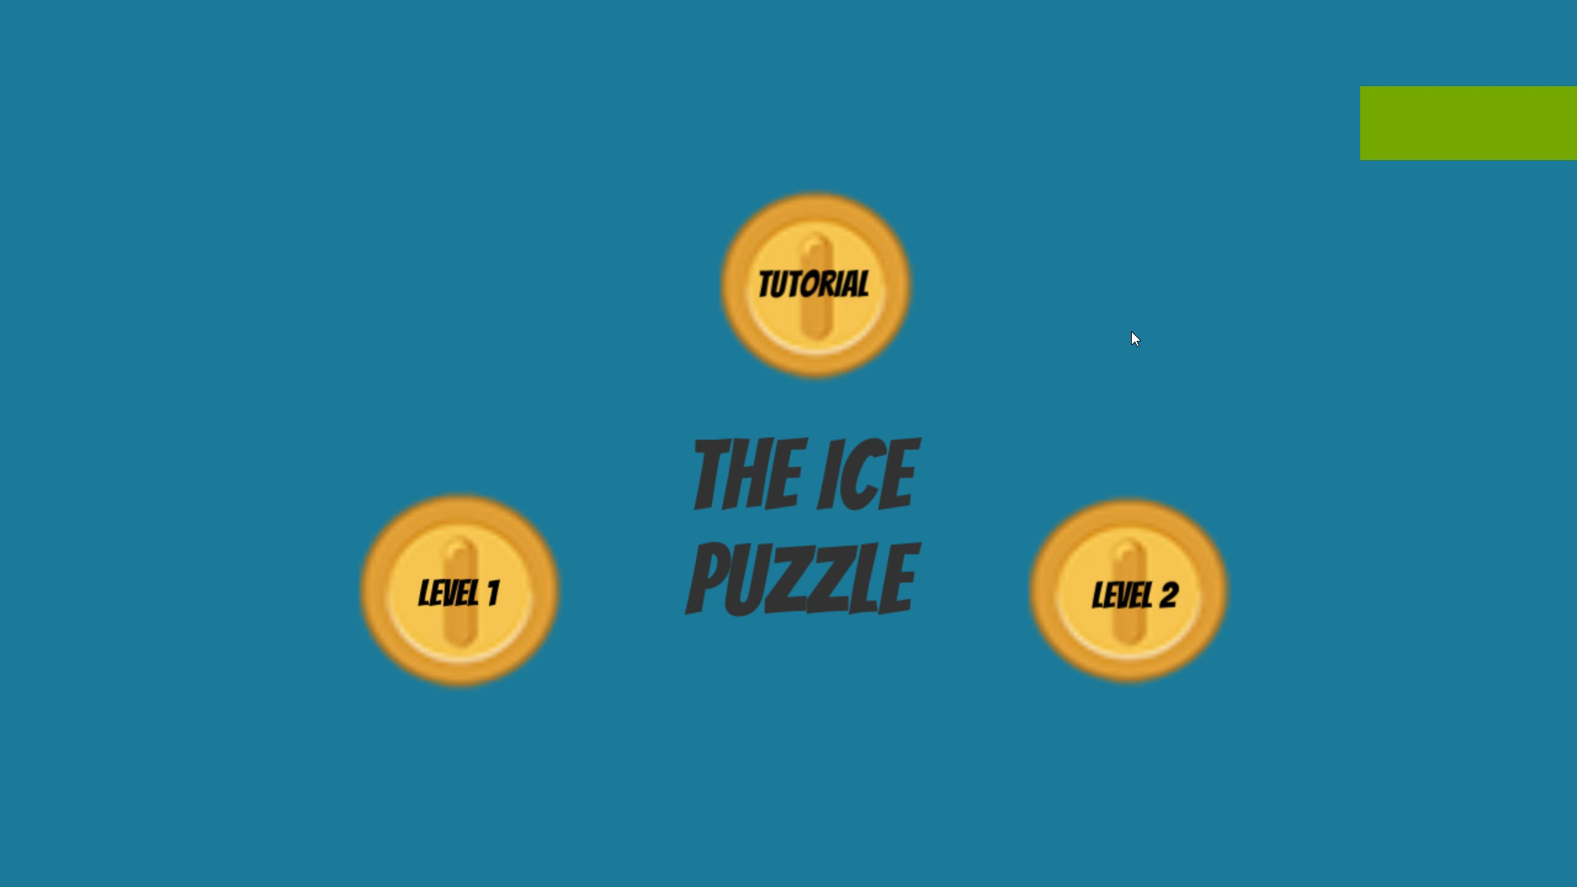
Walkthrough Video

Slide 5
Deliverables – Week 12
3 stages – 9 levels – 1 bonus level – 10 levels in total.
Art assets fully implemented.
Animations
Characters
Scenery
Objects, pickups and props.
Audio
Playtesting sessions – Refine core game loop.
All planned mechanics to be completed and implemented.
Ghost enemy
Coins and Keys

Slide 6

Any Questions?

